Slide 1
EENG 385 Full Bridge Rectifier
Notes:
Usually the <title of the lab> is what will be called the “System” through the rest of this document

Slide 2
Lab Objectives
Study the theory, simulation and implementation of a full-bridge rectifier.

Slide 3
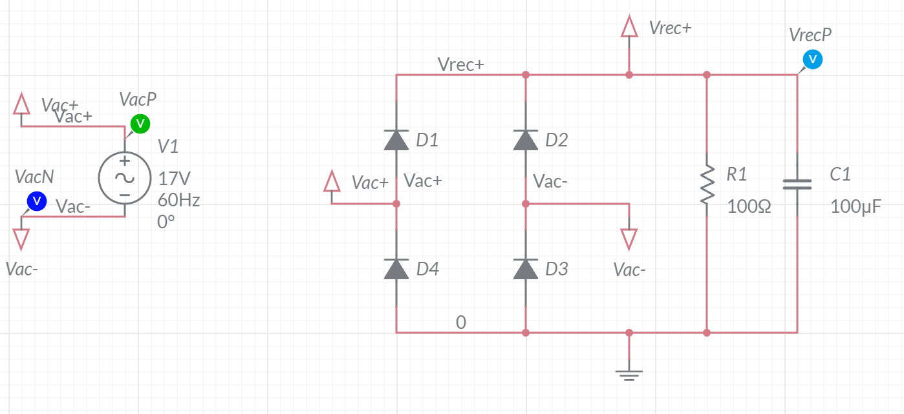
Circuit
Full Bridge Rectifier
AC input – 60Hz, 17V peak-to-peak.
DC output – 17V with some “ripple”
Notes:
Replace <System> with the name of the

Slide 4
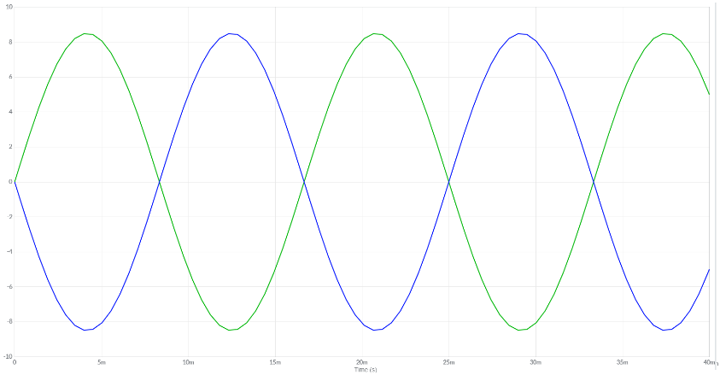
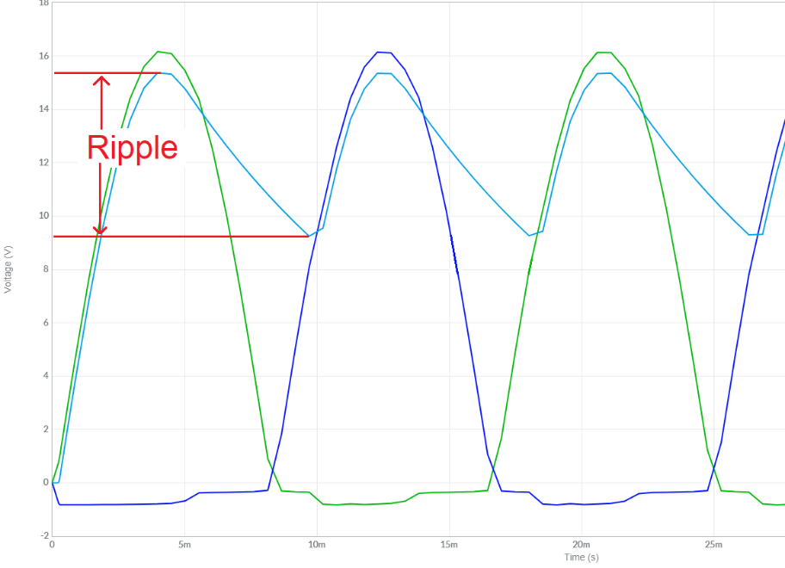
Circuit
Input:
Output:
Small resistor +
Smaller capacitor =
Larger ripple
Notes:
Replace <System> with the name of the

Slide 5
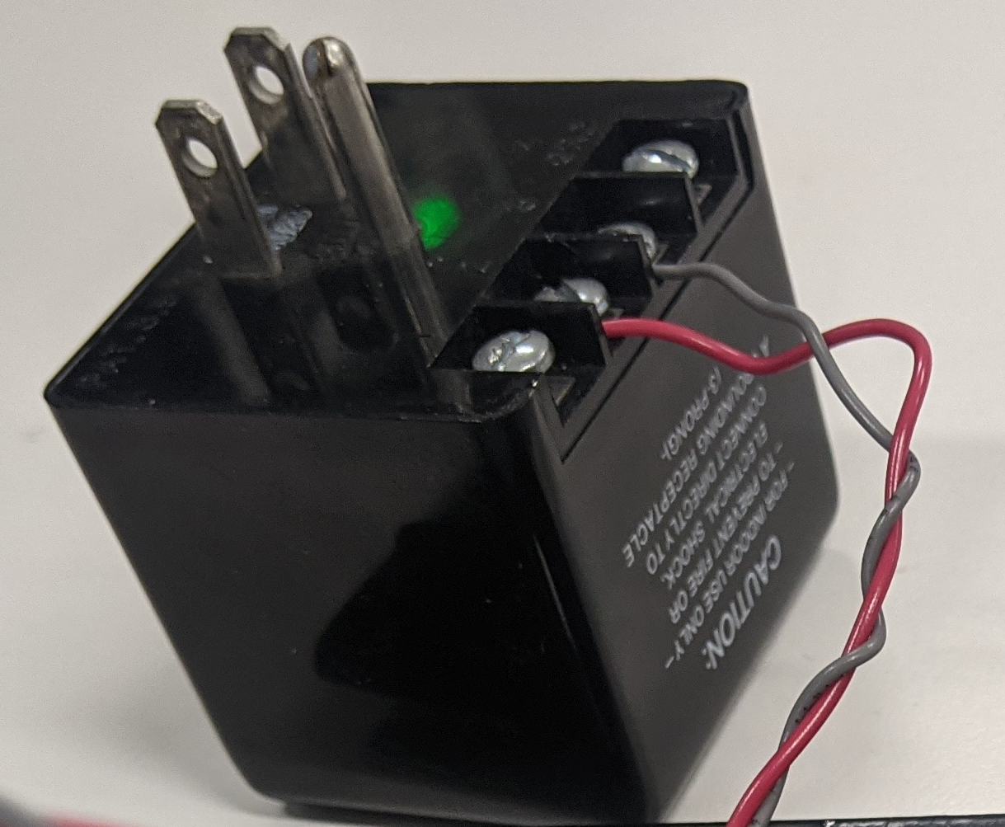
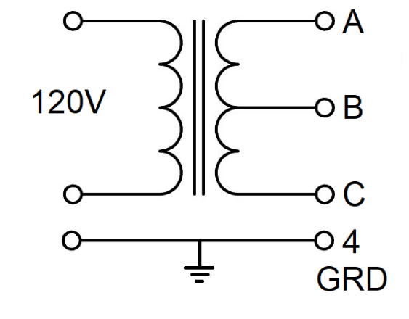
Circuit
KS21239L4 Transformer
Input 120VAC 3-prong plug
Output 4 screw-terminals
Voltage measured RMS
Notes:
Replace <System> with the name of the

Slide 6
Circuit
1N4001 diode
Power diode
Can use MUR106
Insert with pliers
100uF capacitor
Polarized
Insure at least 35V
Notes:
Replace <System> with the name of the

Slide 7
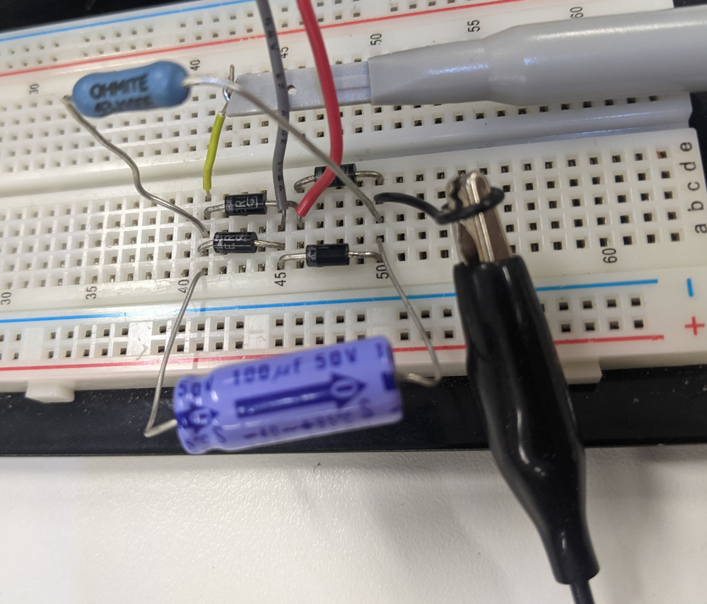
Assembled
Build in 3 stages
Transformer + diodes
Add filter capacitor
Add load resistor
Notes:
Replace <System> with the name of the

Slide 8
Turn In
Make a record of your response to numbered items below
Full Bridge Rectifier Theory
Steps 1 – 8
Full Bridge Rectifier Simulation
Fully completed Table 1
Full Bridge Rectifier Implementation
The KS21239L4 Transformer Steps 1-7
The 1N4001 diode Steps 1-4
Assembly Complete Table 1
Sign-off, successful implementation

